Slide 1
CSC 334 – Parallel and Distributed Computing
Instructor: Ms. Muntha Amjad
Lecture# 05: Parallel Algorithms

Slide 2
Problem
Assume we have a 100-inch sandwich to feed 8 people.
We know how many inches each person wants.
  [6 4 16 10 16 14 2 8]
How do we cut the sandwich quickly? How much will be left?
Method 1: cut the sections sequentially: 6 inches first, 4 inches second, 16 inches third, etc.
Method 2: calculate Prefix sum and cut in parallel
  [6, 10, 26, 36, 52, 66, 68, 76] (24 inches left)

Slide 3
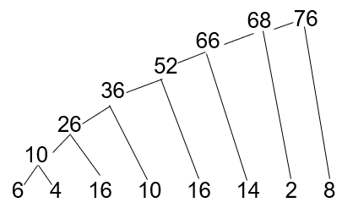

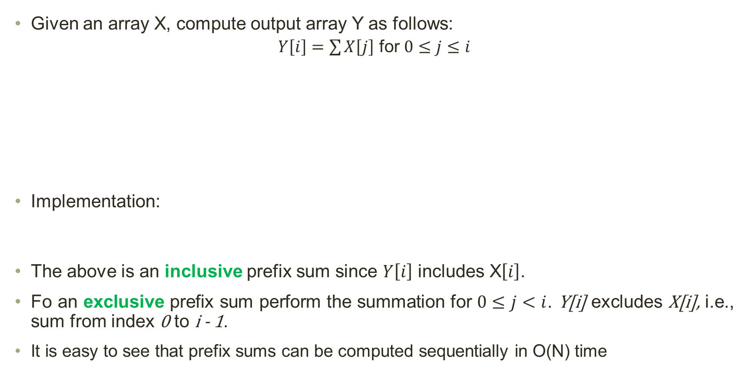
Prefix Sum (Scan)
Given an array X, compute output array Y as follows:
$Y\left[i\right]=\sum{X\left[j\right]}$ for $0≤j≤i$
Implementation:
The above is an inclusive prefix sum since $Y\left[i\right]$ includes X$\left[i\right]$.
Fo an exclusive prefix sum perform the summation for $0≤j<i$. Y[i] excludes X[i], i.e., sum from index 0 to i - 1.
It is easy to see that prefix sums can be computed sequentially in O(N) time
  $$Y_{0}=X_{0}$$
  $$Y_{1}=X_{0}+X_{1}$$
  $$Y_{2}=X_{0}+X_{1}+X_{2}$$
Using recursive definition
  $$Y_{i}=Y_{i−1}+X_{i}$$
Y[0] = X[0];
for (i = 1; i < N; i++)
Y[i] = Y[i-1] + X[i];

Slide 4

Naïve Inclusive Parallel Prefix Sum
Assign one thread to calculate each $Y$ element that adds up all X elements needed for that Y element.
  $Y_{0}=X_{0}$
  $Y_{1}=X_{0}+X_{1}$
  $Y_{2}=X_{0}+X_{1}+X_{2}$
Implementation:
#pragma omp parallel for
for (i = 0; i < N; i++){
Y[i] = 0;
for (j = 0; j <= i; j++)
Y[i] += X[j];
}

Slide 5
Naïve Inclusive Parallel Prefix Sum
10
26
36
52
66
68
76
6
4
10
16
26
10
36
16
52
14
66
2
68
8
6
4
16
52
14
66
2
10
16
26
10
36
6
4
10
36
16
52
14
10
16
26
6
4
26
10
36
16
10
16
6
4
10
16
26
10
6
4
10
16
6
4

Slide 6
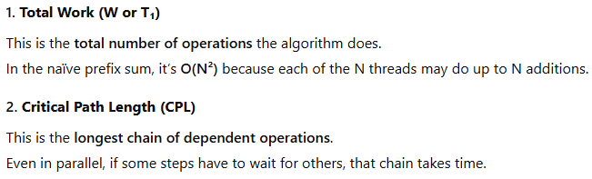


Naïve Inclusive Parallel Prefix Sum
Observations:

Slide 7
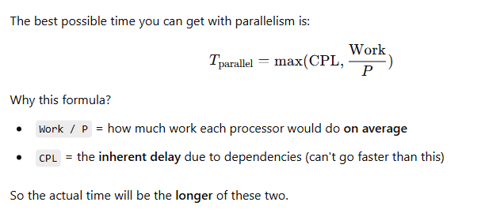
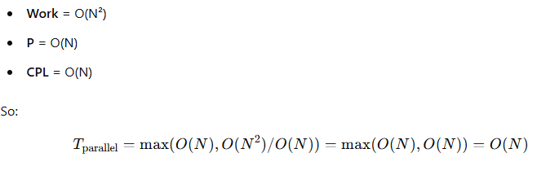
Naïve Inclusive Parallel Prefix Sum
Best-Case Parallel Time:
The time is still O(N) — same as the sequential version! You used lots of processors, but got no speedup. Parallel programming is easy as long as you don’t care about performance.

Slide 8
Parallel Prefix Sum
How to improve efficiency?
  Build a balanced binary tree on the input data and sweep it to and from the root
  Traverse up from leaves to root building partial sums at internal nodes in the tree
    Root holds sum of all leaves
  Traverse back down the tree building the scan from the partial sums

Slide 9
Parallel Prefix Sum: Upward Sweep (Bottom-up)
76
for (i = 0; i < n - 1; i++)
Y[i] = X[i];
for (d = 1; d < n; d *= 2) {
#pragma omp parallel for
for (int i = 0; i < n; i += 2 * d) {
Y[i + 2 * d - 1] += Y[i + d - 1];
}
}
36
40
10
26
30
10
6
4
16
10
16
14
2
8
6 | 4 | 16 | 10 | 16 | 14 | 2 | 8
Step
d =1
6 | 10 | 16 | 26 | 16 | 30 | 2 | 10
d = 2
6 | 10 | 16 | 36 | 16 | 30 | 2 | 40
d = 4
6 | 10 | 16 | 36 | 16 | 30 | 2 | 76

Slide 10
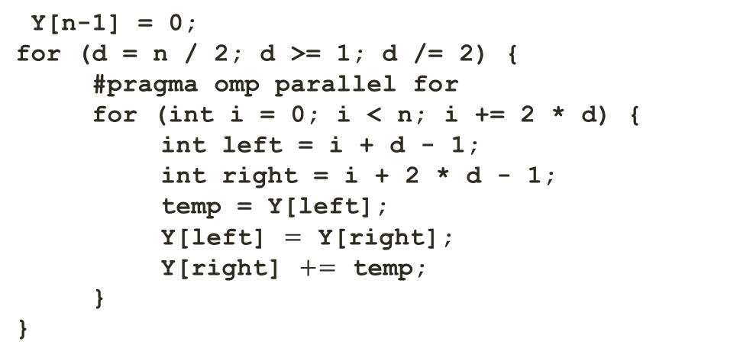
Parallel Prefix Sum: Downward Sweep (Top-down)
0
Y[n-1] = 0;
for (d = n / 2; d >= 1; d /= 2) {
#pragma omp parallel for
for (int i = 0; i < n; i += 2 * d) {
    int left = i + d - 1;
int right = i + 2 * d - 1;
temp = Y[left];
Y[left] $=$ Y[right];
Y[right] $+=$ temp;
}
}
0
36
0
10
36
66
0
6
10
26
36
52
66
68
0
6 | 10 | 16 | 36 | 16 | 30 | 2
Step
d = 4
6 | 10 | 16 | 0 | 16 | 30 | 2 | 36
d = 2
6 | 0 | 16 | 10 | 16 | 36 | 2 | 66
d = 1
0 | 6 | 10 | 26 | 36 | 52 | 66 | 68

Slide 11

Parallel Prefix Sum: Inclusive
for (i = 0; i < n; i++) {
Y[i] += X[i];
}
6 | 4 | 16 | 10 | 16 | 14 | 2 | 8
X
Y
0 | 6 | 10 | 26 | 36 | 52 | 66 | 68
Updated Y
6 | 10 | 26 | 36 | 52 | 66 | 68 | 76

Slide 12
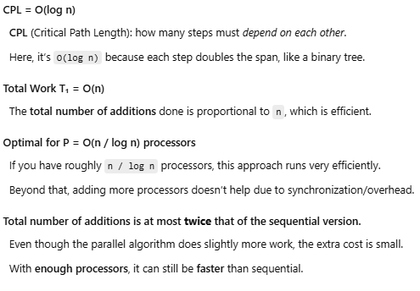
Parallel Prefix Sum: Inclusive
Observations:

Slide 13
Applications of Prefix Sum
Parallel Prefix Sum has several applications that go way beyond computing the
sum of array elements. A key primitive in many parallel algorithms to convert serial computation into parallel computation
  Radix Sort
  String Comparison
  Lexical Analysis
  Stream Compaction
  Polynomial Evaluation
  Solving Recurrences
  Tree Operations
  Histograms
  Assigning space in farmers market
  Allocating memory to parallel threads
  Allocating memory buffer for communication channels
  Frequently used for parallel work assignment and resource allocation

